Slide 1


TELECOM CYBER PORTFOLIO
CONFIDENTIAL / 2026
Executive Review
Telecom Cyber Portfolio
| Executive Review
Cyber delivery is funded, but schedule risk is concentrated
in the integration-heavy work.
PORTFOLIO SNAPSHOT | 2026
10 projects • $2.83M budget • 75.6% average milestone completion
01

Slide 2
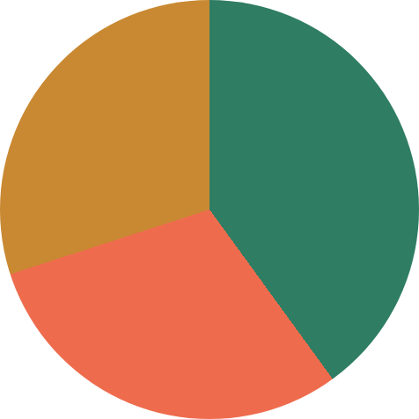
TELECOM CYBER PORTFOLIO
CONFIDENTIAL / 2026
PORTFOLIO OVERVIEW
A funded portfolio with a split health picture
ACTIVE CYBER PROGRAMS
DELIVERY HEALTH
FINANCIAL POSITION
10
4
3
3
$2.83M
budget
10 active cyber security
On Track
Delayed
At Risk
$2.79M actual spend
projects
4 On Track | 3 Delayed | 3 At Risk
Portfolio spend is $40K under
budget (−1.4%)
Management signal: cost is controlled, but delivery is not
PORTFOLIO
HEALTH
The RAG split and milestone gaps point to execution exposure rather than funding
pressure.
02

Slide 3
TELECOM CYBER PORTFOLIO
CONFIDENTIAL / 2026
SCHEDULE PERFORMANCE
Schedule exposure is concentrated
in transformation projects
AVERAGE MILESTONE
COMPLETION
ACTUAL COMPLETION BY PROJECT
100% PLAN
75.6%
Cloud Security Assessment
60.0% complete (−40.0 pts vs plan)
Against a 100% planned
milestone baseline across
the portfolio.
SIEM Migration
63.8% complete (−36.2 pts)
DDoS Protection
65.0% complete (−35.0 pts)
LARGEST GAPS SHOWN
AT RIGHT
Privileged Access Management
66.2% complete (−33.8 pts)
The critical path is slowing where integrations, vendors and specialist skills converge
03

Slide 4
TELECOM CYBER PORTFOLIO
CONFIDENTIAL / 2026
FINANCIAL EXPOSURE
Underspend is masking delivery slippage
DELAYED-PROJECT VARIANCE
DELAYED PROJECT COST VARIANCE
BUDGET IMPACT
+$70K
DDoS Protection
+$30K | +9.4%
Delayed projects are collectively
$70K over budget
Cloud Security Assessment
+$25K | +16.7%
NextGen Firewall Upgrade
+$15K | +6.0%
PORTFOLIO TOTAL
−$40K
Portfolio total is still $40K
under budget because several
projects are underspending
while behind plan
Treat underspend as
unconsumed delivery, not
Portfolio total is still $40K under
budget
savings
04

Slide 5
TELECOM CYBER PORTFOLIO
CONFIDENTIAL / 2026
RISK AND ISSUE CONCENTRATION
Risk is clustered around
integration and capacity
PORTFOLIO RISK REGISTER
Integration
Capacity
Vendor
15
Legacy log-source
SOC and cloud
Firewall and DDoS
integration and PAM
security specialist
deployment
compatibility are
shortages are
dependencies
15 risks logged
critical exposures.
slowing execution.
require escalation.
7
STEERING PRIORITIES
critical score-9 risks
Top steering priorities: legacy
SOC engineering capacity
log-source integration
11
DDoS vendor deployment
Mitigation pattern: add
open
specialist capacity, prioritize
critical integrations, and
escalate vendors weekly
05
Risk owners: CISO, SOC Manager, SIEM Manager,
Vendor Manager
OPEN EXPOSURE REQUIRES
ACTION

Slide 6
TELECOM CYBER PORTFOLIO
CONFIDENTIAL / 2026
MANAGEMENT ACTION
Three decisions to restore delivery confidence
01
02
03
Stabilise delayed programs:
sponsor vendor escalations,
backup suppliers and protected
test environments
Protect the SOC/SIEM critical
path: add specialist capacity
and prioritize critical log
sources
Turn the portfolio into an
early-warning system: weekly RAG
review with triggers at <90% of
plan, risk score ≥9, or cost
variance >5%
DECISION REQUESTED
approve targeted capacity and vendor intervention now — before
delays become operational exposure
Telecom Cyber Portfolio | Executive Review
Source: supplied project, milestone, financial and risk register data
06

Slide 7
TELECOM CYBER PORTFOLIO
TASK 4 / PROCESS DESIGN
TASK 4 | PROCESS AND WORKFLOW DESIGN
Tracking Cyber Project Progress & Reporting
A controlled weekly loop from source data to stakeholder action — with validation before
anything reaches the dashboard.
01
02
03
04
Data collection
Validate & approve
Export & dashboard
Stakeholder
PMs update MySQL
BA checks completeness,
update
reporting
tables: Projects,
dates, Planned % vs
Export validated MySQL
Share the dashboard and
Milestones, Tasks,
→
Actual %, status, cost
→
tables to dated CSV,
→
executive summary with
Risks_Issues and
variance and risk scores.
refresh Power BI Power
CISO, sponsors and PMs;
Resources.
Query, then confirm RAG,
capture decisions and
GATE: APPROVE OR
RETURN
schedule, financial and
actions.
OWNER: PM / PMO
risk visuals.
OUTPUT: ACTION LOG
CONTROL: REFRESH
CHECK
Exception loop: failed validation or refresh → return to owner →
correct source data → revalidate → re-export → refresh again
WEEKLY CUT-OFF: THURSDAY
DASHBOARD REFRESH: FRIDAY
STEERING REVIEW: MONDAY
07

Slide 8
